Slide 1
The Relationship Between Energy Consumption and Economic Growth for Different Country Groups
Dr. Nermin Yaşar

Slide 2
Introduction
Unlike the previous studies, this article examines the causal relationship between energy consumption and economic growth for a sample of 119 countries classified into four groups, according to the Word Bank income ranking

Slide 3
Introduction
This study is organized in the following way
literature survey on the relationship between energy consumption and economic growth
theoretical framework
empirical model specification and estimation techniques
empirical results and concluding remarks

Slide 4
Literature Survey
The literature on the relationship between energy use and economic growth can be divided into four generations
VAR methodology and Granger’s causality testing (Kraft and Krfat (1978)...
Granger (1988) two-stage procedure and VECM (Glasure and Lee (1997)...
Multivariate estimators (Johansen, 1991) (Masih and Masih (1996)...
Panel co-integration and panel-based ECM (Lee (2005)...

Slide 5
Theoretical Framework of Relationship between Energy Consumption and Economic Growth
From demand side of economy
Consumption of the energy resources such as crude oil, natural gas, coal or electricity maximizes households’ utility by meeting their different needs as a final consumer goods
From supply side of economy
However, there are two opposite views in the literature on the impact of energy sources on the supply side of the economy.

Slide 6
Theorical Framework of Relationship between Energy Consumption and Economic Growth
From supply side of economy
Neoclassical economic growth models
Y = Y (K, L)
Critique of Neoclassical economic growth models
Y = f (K, L, S),
where S is a productive energy

Slide 7
Theorical Framework of Relationship between Energy Consumption and Economic Growth
In the context of the Granger Causality the relationship between energy consumption and GDP
Growth hypothesis
EC → GDP
Conservation hypothesis
EC ← GDP
Neutrality hypothesis
EC - - GDP
Feedback hypothesis
EC <--> GDP

Slide 8
Econometric Methodology
This study analyses the relationship between energy consumption and GDP for 119 countries during the period of 1970-2015, applying panel data research techniques
The real GDP data is indicated in billions of constant 2001 U.S. dollars, whereas energy use is in kg of oil equivalent per capita

Slide 9
Econometric Methodology
Unit Root Analysis
Breitung (2000),
Levin ,Lin and Chu (2002)
H0 : Series include common or panel unit root
Im, Peseran and Shin (2003)
Fisher- ADF
Fisher- PP
H0: Series include individual unit root

Slide 10
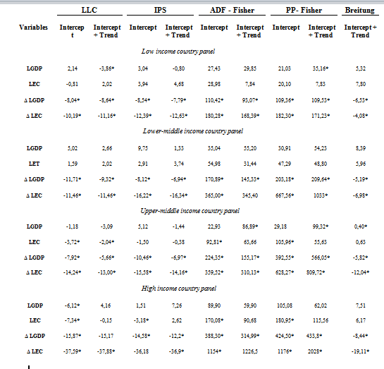
Unit Root Test Results
Note: *indicates significance at the 5% level. Abbreviations defined as follows: LGDP log of log of gross domestic product, LEC log of energy consumption

Slide 11
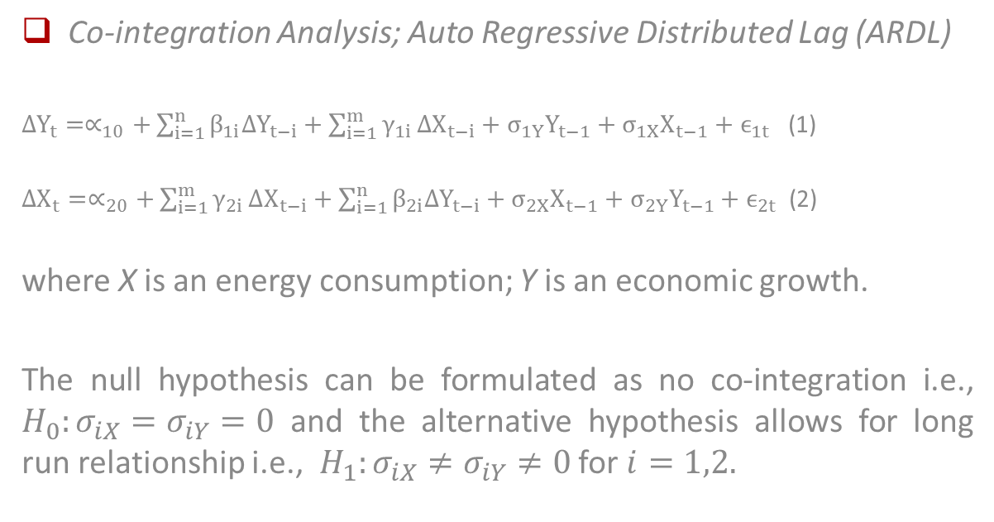
Econometric Methodology
Co-integration Analysis; Auto Regressive Distributed Lag (ARDL)
$∆Y_{t}=∝_{10}+\sum_{i=1}^{n}{β_{1i}∆Y_{t−i}}+\sum_{i=1}^{m}{γ_{1i}}∆X_{t−i}+σ_{1Y}Y_{t−1}+σ_{1X}X_{t−1}+ϵ_{1t}$ (1)
$∆X_{t}=∝_{20}+\sum_{i=1}^{m}{γ_{2i}}∆X_{t−i}+\sum_{i=1}^{n}{β_{2i}∆Y_{t−i}}+σ_{2X}X_{t−1}+σ_{2Y}Y_{t−1}+ϵ_{2t}$ (2)
where X is an energy consumption; Y is an economic growth.
The null hypothesis can be formulated as no co-integration i.e., $H_{0}:σ_{iX}=σ_{iY}=0$ and the alternative hypothesis allows for long run relationship i.e., $H_{1}:σ_{iX}≠σ_{iY}≠0$ for $i=1,2.$

Slide 12
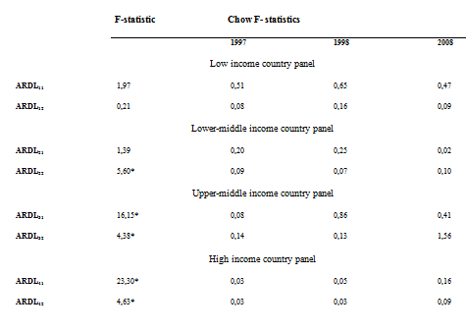
Co-Integration and Chow Tests Results
Note: *indicates significance at the 5% level

Slide 13
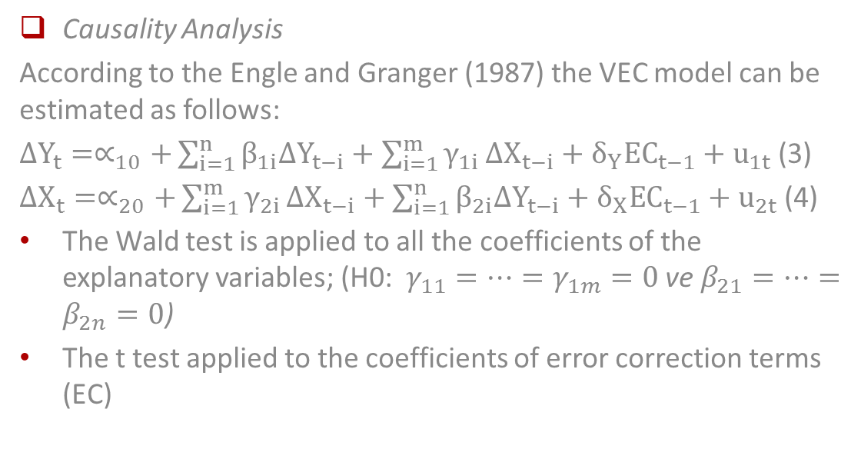
Econometric Methodology
Causality Analysis
According to the Engle and Granger (1987) the VEC model can be estimated as follows:
$∆Y_{t}=∝_{10}+\sum_{i=1}^{n}{β_{1i}∆Y_{t−i}}+\sum_{i=1}^{m}{γ_{1i}}∆X_{t−i}+{δ_{Y}EC}_{t−1}+u_{1t}$ (3)
$∆X_{t}=∝_{20}+\sum_{i=1}^{m}{γ_{2i}}∆X_{t−i}+\sum_{i=1}^{n}{β_{2i}∆Y_{t−i}}+{δ_{X}EC}_{t−1}+u_{2t}$ (4)
The Wald test is applied to all the coefficients of the explanatory variables; (H0: $γ_{11}=…=γ_{1m}=0$ve $β_{21}=…=β_{2n}=0$)
The t test applied to the coefficients of error correction terms (EC)

Slide 14
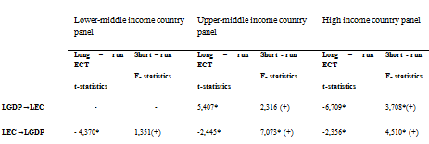
Causality Test Results
Note: F-statistics reported with respect to short-run causality. Lag lengths are selected according to AIC. The sum of the coefficients is reported in parenthesis.

Slide 15
Conclusion
Differs depending on which income group country belongs to
The neutrality hypothesis is supported for low income and lower middle income countries in the short run
The conversation hypothesis is supported for lower middle income countries in the long run and for upper middle income countries in the short run
The feedback hypothesis is supported for upper middle income in long run and for high income countries groups

Slide 16
Thank you...

