Slide 1
The Effects of Maternal Employment and
Non-Parental Child Care on Early Childhood Development
Didem Pekkurnaz
May 2015

Slide 2
Agenda
Motivation
Theoretical Model
Data
Empirical Model
Results

Slide 3
Motivation
Early childhood health conditions impact young adult measures of cognition (e.g., college math and literacy scores).
Such cognitive skills are more strongly affected by parental inputs at early ages than at later ages.
Cognitive skills as well as non-cognitive skills (e.g., emotional control, self esteem, attention) impact economic outcomes such as schooling and wages.
During the early stages of a child’s life, mothers and child caregivers play a big role.

Slide 4
Motivation
Parental Inputs
Cognitive Skills
Health
Economic Outcomes
Non-Cognitive Skills
Non-Parental Child Caregiver Inputs
Early Childhood and Adolescence
Young Adult and Adult

Slide 5
How do we measure these potentially important inputs?
Parental Inputs
    Amount of maternal time with child (e.g., employment)
    Quality of maternal time with child (e.g., reading, playing)
    Household inputs (e.g., books, tutoring, food)
Caregiver Inputs
    Type of child care (relative, non-relative, center based)
    Hours of child care of each type
    Quality of child care of each type
Big Picture : What are the roles of these inputs in understanding the relationship between health, cognitive skills, and non-cognitive skills during early childhood?

Slide 6
Previous Work and Potential Problems
Joint maternal employment and non-parental child care considerations
Omitted variable bias
  Home quality
  Child care quality
Unobserved heterogeneity bias
  Endogeneity of maternal employment, child care and quality variables
Duncan and NICHD (2003), Gordon et al. (2007), Hubbard (2009), Ding et al. (2009), Bernal and Keane (2010, 2011), Griffen (2011), Fletcher and Lehrer (2011), Kottelenberg and Lehrer (2013), Herbst (2013)

Slide 7
My Contributions
Analyze impact of both maternal employment and child care choices
Include home quality and child care quality measures
Control for endogeneity of maternal employment and quality variables using a two-step system GMM within a dynamic framework
Examine the relationship between health conditions, cognitive skills and non-cognitive skills while controlling for their endogeneity

Slide 8
Key Findings
Policy Outcomes
  - High quality in-home non-parental child care reduces a child’s risk of being overweight.
  - High quality out-of-home non-parental child care reduces bad behavior and improves cognitive achievement.
  - Increase in maternal hours of work increases the obesity risk.
  - Obesity reduces the cognitive achievement of a child in early childhood.
Role of Observed Quality
  - Quality is a significant input.
  - Omission of quality alters the significance/magnitudes of hours of work and child care variables.
Role of Unobserved Heterogeneity
  - Coefficient estimates change after controlling for the unobserved heterogeneity.
  - Child care quality variables have expected signs.

Slide 9
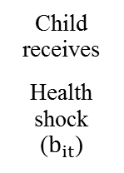
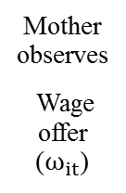
Theory of Dynamic Decision Making
Information
entering period t
Health outcome ($H_{it}$)
Health outcome (H_it)
Stage One
Hours of work ($E_{it}$)
Hours of work (E_it)
Updated Information
moving into period t+1
Cognitive achievement $(Q_{it}$)
Cognitive achievement (Q_it)
Non-cognitive skills ($B_{it}$)
Non-cognitive skills (B_it)
Demographics ($X_{it}$)
Demographics (X_it)
Prices and state/county level variables ($P_{t},Z_{t}$)
Prices and state/county level variables (P_t,Z_t)
Hours of child care ($C_{it}^{h}$)
Hours of child care (C_it^h)
Stage Two
Quality of child care ($K_{it}$)
Quality of child care (K_it)
Quality of home inputs (i.e. observed goods and time inputs) ($A_{it}$:{$G_{it}^{A}$,$L_{it}^{mA}$})
Quality of home inputs (i.e. observed goods and time inputs) (A_it:{G_it^A,L_it^mA})
Unobserved (to researcher) goods and time inputs (e.g. medical care) $(G_{it}^{\overline{A}},L_{it}^{m\overline{A}}$)
Unobserved (to researcher) goods and time inputs (e.g. medical care) (G_it^¯A,L_it^(m¯A))
Non-cognitive skills ($B_{it+1}$)
Non-cognitive skills (B_(it+1))
Demographics ($X_{it+1}$)
Demographics (X_(it+1))
Prices and state/county level variables ($P_{t+1},Z_{t+1}$)
Prices and state/county level variables (P_(t+1),Z_(t+1))
Health outcome ($H_{it+1}$)
Health outcome (H_(it+1))
Cognitive achievement $(Q_{it+1}$)
Cognitive achievement (Q_(it+1))
Mother observes
Wage offer ($ω_{it}$)
Child receives
Health shock ($b_{it}$)

Slide 10
Theoretical Motivation
Mother chooses employment, child care and all other inputs to maximize discounted lifetime utility. Per-period components of her decision making problem are:
  Utility
    depends on her own leisure and consumption, as well as time spent with the child, her child’s health, cognitive achievement and non-cognitive skills, health shocks
  Time Constraint
    - available time is spent on hours of work and her own leisure time as well as time spent with the child
  Budget Constraint
    earned and unearned income is spent on consumption, child care, and other inputs
  Health Production, Cognitive Achievement and Non-Cognitive Skills
    all are determined by health, cognitive achievement and non-cognitive skills entering period, and maternal time, child care, and quality inputs during the period and the health shock
  Unobserved permanent and time-varying heterogeneity
The resulting demand (hours, childcare, quality) and production (health, cognitive achievement and non-cognitive skills) equations define inclusion of endogenous determinants as well as theoretically-relevant identifying variables.

Slide 11
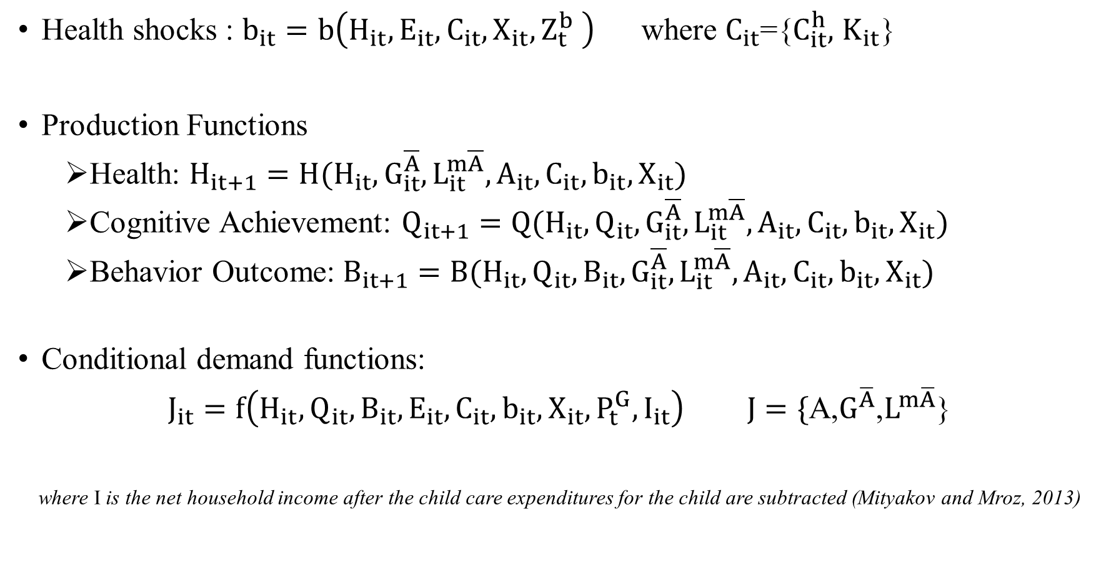
More specifically…
Health shocks : $b_{it}=b\left(H_{it},E_{it},C_{it},X_{it},Z_{t}^{b} \right)$ where $C_{it}$={$C_{it}^{h},$ $K_{it}$}
Production Functions
  Health: $H_{it+1}=H(H_{it},G_{it}^{\overline{A}},L_{it}^{m\overline{A}},A_{it},C_{it},b_{it},X_{it})$
  Cognitive Achievement: $Q_{it+1}=Q(H_{it},Q_{it},G_{it}^{\overline{A}},L_{it}^{m\overline{A}},A_{it},C_{it},b_{it},X_{it})$
  Behavior Outcome: $B_{it+1}=B(H_{it},Q_{it},{B_{it},G}_{it}^{\overline{A}},L_{it}^{m\overline{A}},A_{it},C_{it},b_{it},X_{it})$
Conditional demand functions:
$J_{it}=f\left(H_{it},Q_{it},B_{it},E_{it},C_{it}, b_{it},X_{it},P_{t}^{G},I_{it}\right) J=\{$A,$G^{\overline{A}}$,$L^{m\overline{A}}$}
where I is the net household income after the child care expenditures for the child are subtracted (Mityakov and Mroz, 2013)

Slide 12

More specifically…
Hybrid production functions:
$F_{it+1}=f(H_{it},Q_{it},B_{it},{E_{it},C}_{it},A_{it}, b_{it},X_{it}, P_{t}^{G}, I_{it})$ for F=H$\text{,}$Q, B
Also, marital status (M)$,$ number of children (N), mother’s education (S), and net hh income (I) are assumed to be endogenous in the empirical work.

Slide 13
Data
Early Childhood Longitudinal Study-Birth Cohort (ECLS-B) follows almost 14,000 children born in 2001 from birth through kindergarten entry (5 waves).
Parents’ employment/hours, earnings, demographic variables, child care arrangements (relative, nonrelative, center based), child’s health, cognitive and non-cognitive development, interview with child care and early education providers starting when the children were 2 years old
Health variables:
                General health status of children reported by the parent
                Obesity and overweight status
                Prevalence of ear infections and respiratory illnesses reported by the parent (health shock)
Cognitive achievement and behavior outcome measures

Slide 14
Data: Cognitive and Non-Cognitive Skills
Cognitive Achievement
  Bayley Short Form- Research Edition (BSF-R) (uses Bayley Scales for Infant Development) at wave 1 and wave 2
  For other waves, math and reading test scores are used.
Behavior Outcome (Non-Cognitive)
  Variables related with internalizing and externalizing behaviors, social interaction, concentration, attention problems are used to create this index.
Use the detailed, numerous variables to construct an index based on estimated first principal components using factor analysis.

Slide 15
Data: Quality Measures
Home Quality
  Home environment and parenting style such as number of books at home and how frequently the mother reads books to her child and visits a library with her child
  Nutrition information (limited) such as the type of beverage a child drinks with meals and frequency of fast food eaten in the past 7 days
Child Care Quality
  Structural quality measure: group size
  Process quality for primary child care (in-home & out-of-home): child care environment and interaction between child care provider and the child such as number of soft toys and frequency of activities (e.g. math games, practice writing)
Use the detailed, numerous variables to construct an index based on estimated first principal components using factor analysis.

Slide 16
Data: Exogenous Variables used as Instruments
Instruments
  Average state level child care prices
  Unemployment rate, employment in service sector, employment in good sector, poverty, number of child care establishments, wage rate of child care workers
  TANF, child support, median household income, average state wage rate
  2-year public , 4-year public & private university tuitions
  Measures of rain fall and snow fall
State/County level variables for goods/services
  # of supermarkets and grocery stores, fruit and vegetable markets, convenience stores, museums, fitness centers, zoos, full service and limited service restaurants, different types of hospitals, offices of physicians, offices of dentists, office supplies and stationery stores

Slide 17
Descriptive Statistics: Average Values of Variables by Outcome
Variable | Obese | Not Obese | Overweight | Not Overweight | Poor Health | Good Health
Hours of work | 20.99 | 19.29 | 20.86 | 18.97 | 17.61 | 19.54
Hours of child care
center-based | 8.76 | 7.94 | 8.71 | 7.78 | 7.36 | 7.80
home-based | 11.15 | 10.49 | 11.13 | 10.36 | 10.68 | 10.59
Quality Index
home | -0.08 | 0.03 | -0.05 | 0.04 | -0.28 | 0.05
in-home-child care | -0.00 | -0.00 | -0.00 | -0.00 | -0.01 | 0.00
out-of-home child care | 0.03 | -0.01 | 0.01 | -0.01 | 0.02 | -0.01
N | 20400 |  | 20400 |  | 23650
significance: 5% 10%
Outcome

Slide 18
Descriptive Statistics: Average Values of Outcome by Variables
Variables |  | Obese | Overweight | Good Health | Cognitive Achievement | Behavior index
Ear infection | Yes | 0.14 | 0.30 | 0.82 | 0.06 | -0.02
 | No | 0.14 | 0.30 | 0.87 | 0.04 | -0.07
Respiratory Illness | Yes | 0.15 | 0.32 | 0.75 | -0.03 | 0.02
 | No | 0.14 | 0.30 | 0.87 | 0.06 | -0.06
Obese | Yes |  |  |  | -0.07 | 0.01
 | No |  |  |  | 0.06 | -0.06
N |  | 20400 | 20400 | 23650 | 20850 | 21050
significance: 5%
Outcome
Notes:
Add to title

Slide 19
Empirical Model: Estimation using Two-step system GMM
$H_{it}=α_{0}+{α_{1}H}_{it−1}+{α_{2}Q}_{it−1}+{α_{3}B}_{it−1}+{α_{4}R}_{it−1}+{α_{5}X}_{it−1}+{α_{6}Z}_{t−1}+{µ_{i}}^{H}+{ϵ_{it}}^{H}$ level equation
${ΔH}_{it}={α_{1}ΔH}_{it−1}+{α_{2}ΔQ}_{it−1}+{α_{3}ΔB}_{it−1}+α_{4}ΔR_{it−1}+{α_{5}ΔX}_{it−1}+{α_{6}ΔZ}_{t−1}+Δ{ϵ_{it}}^{H}$ differenced equation
where${ R}_{it−1}$contains lagged hours of work, child care hours, quality variables, marital status, university degree of the mother, number of siblings and net household income.
Correlations:
${ΔH}_{it−1}$=$H_{it−1}$ -$H_{it−2}$ is correlated with $Δ{ϵ_{it}}^{H}$=${ϵ_{it}}^{H}$-${ϵ_{it−1}}^{H}$
$H_{it−2}$ is correlated with ${ΔH}_{it−1}$ but orthogonal to $Δ{ϵ_{it}}^{H}$ if errors are serially uncorrelated so $H_{it−2}$can be an instrument for ${ΔH}_{it−1}$in first difference equation.

Slide 20
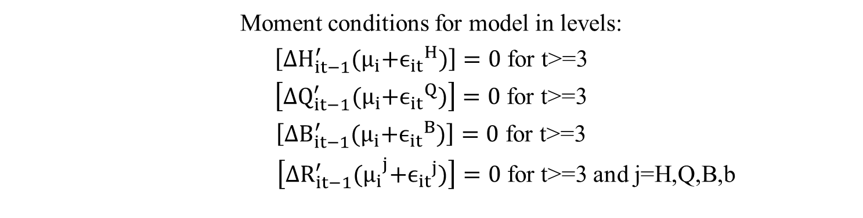
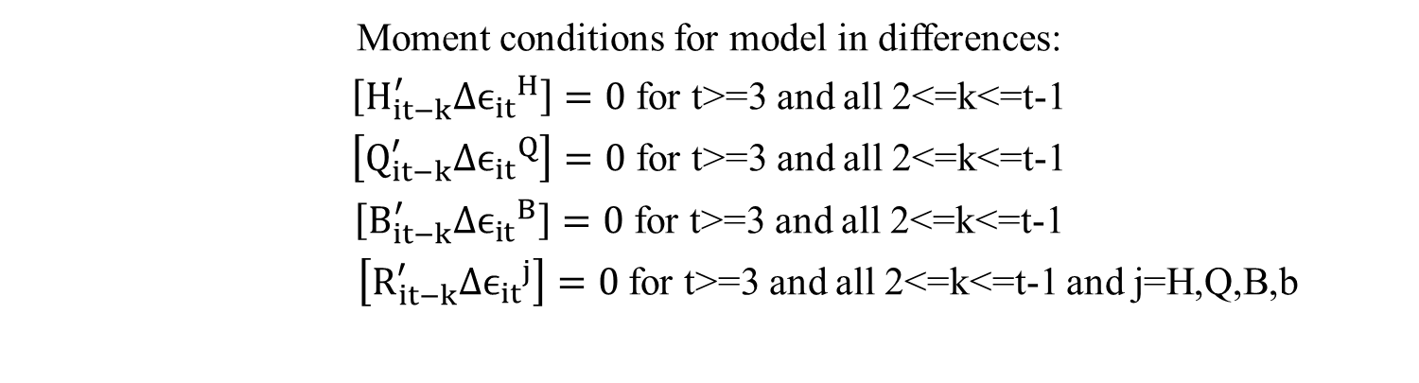
Empirical Model: Estimation using Two-step system GMM
Moment conditions for model in differences:
$\left[H_{it−k}^{′}Δ{ϵ_{it}}^{H}\right]=0$ for t>=3 and all 2<=k<=t-1
$\left[Q_{it−k}^{′}Δ{ϵ_{it}}^{Q}\right]=0$ for t>=3 and all 2<=k<=t-1
$\left[B_{it−k}^{′}Δ{ϵ_{it}}^{B}\right]=0$ for t>=3 and all 2<=k<=t-1
$\left[R_{it−k}^{′}Δ{ϵ_{it}}^{j}\right]=0$ for t>=3 and all 2<=k<=t-1 and j=H,Q,B,b
Moment conditions for model in levels:
$\left[{ΔH}_{it−1}^{′}{(μ}_{i}+{ϵ_{it}}^{H})\right]=0$ for t>=3
$\left[ΔQ_{it−1}^{′}{(μ}_{i}+{ϵ_{it}}^{Q})\right]=0$ for t>=3
$\left[ΔB_{it−1}^{′}{(μ}_{i}+{ϵ_{it}}^{B})\right]=0$ for t>=3
$\left[ΔR_{it−1}^{′}{(μ_{i}}^{j}+{ϵ_{it}}^{j})\right]=0$ for t>=3 and j=H,Q,B,b

Slide 21
Empirical Implementation
Two step system GMM
Estimate the model in differences and levels jointly, for each outcome, using moment conditions of lagged differences as instruments for the level equation and moment conditions of lagged levels as instruments for the first difference equation.
Address any additional correlation between explanatory variables and the error term (e.g. time-invariant in level eqn. and time varying in first difference eqn.) using exogenous instruments, in addition to the GMM style instruments, to improve identification.
Specification tests
Check if second-order autocorrelation exists in the first-differenced errors
Check Overidentification (Sargan test)

Slide 22
Results: Cognitive Achievement
Variables | RE Model 1 | RE Model 2 | RE Model 3 | FE Model 1 | FE Model 2 | FE Model 3 | GMM Model 1 | GMM Model 2
Hours of work | 0.006 | 0.009 | 0.008 | 0.000 | 0.003 | 0.004 | 0.047 | 0.071
Hours of child care
center based | 0.030 | 0.034 | 0.034 | 0.028 | 0.027 | 0.023 | 0.282 | 0.303
home based | 0.002 | 0.005 | 0.007 | -0.008 | -0.010 | -0.010 | 0.102 | 0.075
Quality index
home |  | 0.082 | 0.074 |  | 0.056 | 0.057 |  | 0.104
In-home child care |  | 0.024 | 0.017 |  | 0.009 | 0.006 |  | 0.040
out-of-home child care |  | 0.009 | 0.011 |  | -0.001 | -0.003 |  | 0.346
Obese | -0.065 | -0.064 | -0.062 | -0.084 | -0.083 | -0.083 | -0.055 | -0.131
Exogenous Variables | No | No | Yes | No | No | Yes | Yes | Yes
N | 20850
 | significance: 1% 5% 10%
Outcome

Slide 23
Results: Cognitive Achievement
10 fewer hours of center-based child care ≡ $2525 more weekly net hh income
1 SD decrease in out-of-home cc quality ≡ $2882 more weekly net hh income
1 SD decrease in home quality ≡ $ 865 more weekly net hh income
Being an obese child ≡ $1093 more weekly net hh income

Slide 24
Results: Non-Cognitive and Health Outcomes
Variable | Behavior Index GMM Model | Obesity GMM Model | Overweight GMM Model | Good Health GMM Model
Hours of work | -0.096 | 0.035 | -0.011 | 0.029
Hours of child care
center based | -0.064 | 0.001 | -0.001 | -0.021
home based | 0.035 | 0.020 | 0.030 | -0.037
Quality index
home | -0.199 | -0.064 | -0.071 | 0.055
in-home child care | -0.326 | -0.126 | -0.288 | 0.068
out-of-home child care | -0.228 | -0.005 | -0.001 | 0.009
N | 21050 | 20400 | 20400 | 23650
 | significance: 1% 5% 10%
Outcome

Slide 25
Results: Non-Cognitive Outcome
10 fewer hours of work = $ 876 more weekly net household income
1 SD decrease in home quality = $1790 more weekly net household income
1 SD decrease in out-of-home cc quality = $2074 more weekly net household income
Notes:
Line up eqauls

Slide 26
Results: Health Shocks
Outcome
Variable | Ear Infection Model 1 | Ear Infection Model 2 | Respiratory Illness Model 1 | Respiratory Illness Model 2
Hours of work | 0.019 | 0.024 | -0.026 | -0.017
Hours of child care
center based | 0.032 | -0.002 | 0.031 | 0.001
home based | -0.041 | -0.046 | -0.005 | -0.047
Quality index
in-home child care | -0.111 |  | -0.097
out-of-home child care | -0.011 |  | -0.057
Group size
center based care |  | 0.004 |  | 0.019
home based care |  | 0.096 |  | 0.008
N | 22750 |  | 21200
 | significance: 1% 5% 10%

Slide 27
Conclusion
Not only the amount of time but also the quality of the time spent with a child is important for child development; this holds true for both parental and non-parental child care.
The adverse effect of obesity on a child’s cognitive development begins even in early childhood.
It is important to control for the endogeneity of variables e.g. maternal employment, child care and quality variables.

Slide 28
Extension
To improve efficiency estimate the child outcomes and mother’s choices (work, non-parental child care, marital status, number of children and education) jointly using Discrete Factor Random Effects (DFRE) model where both time-invariant and time-varying unobserved heterogeneity are approximated as a discrete step-wise function (Heckman and Singer, 1984; Mroz and Guilkey, 1992 and Mroz, 1999).
Application on Turkish Data

Slide 29
Thank You!

